Slide 1

Object Detection
Yun Liu
Media Computing Lab
nk12csly@mail.nankai.edu.cn

Slide 2
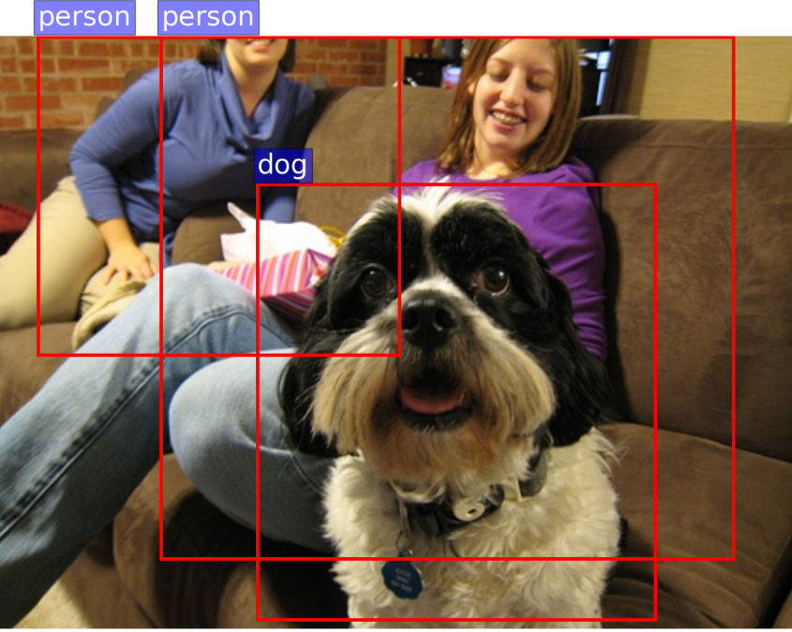
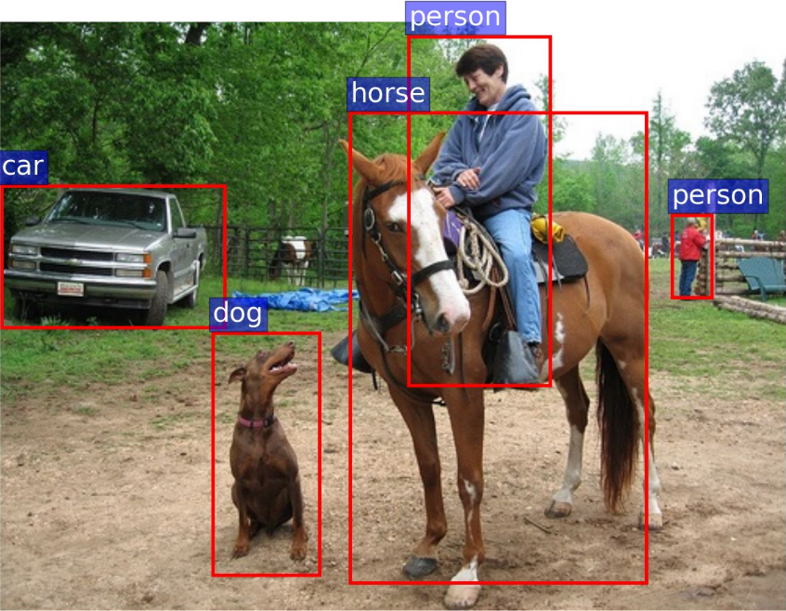
What is object detection?
Object detection is to detect meaningful objects that we care about in images and videos. Both the category and location should be worked out.

Slide 3
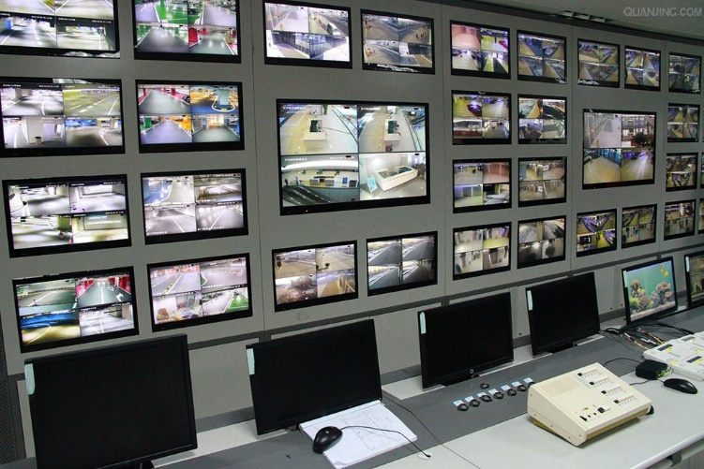

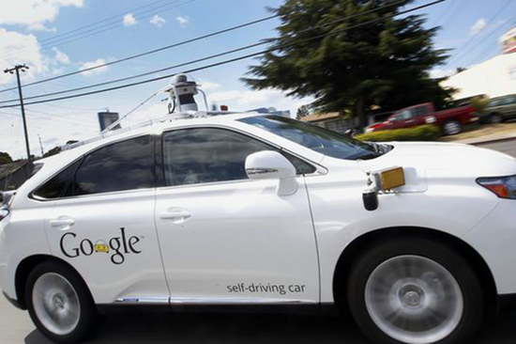
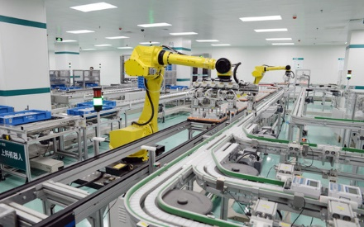
Applications

Slide 4
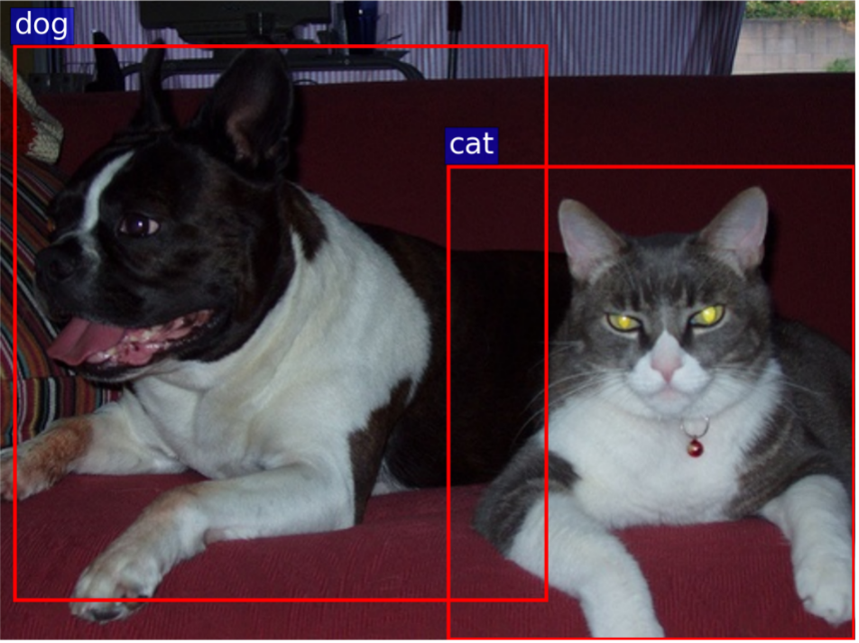
Q1: What is the object? (Global information)

Slide 5
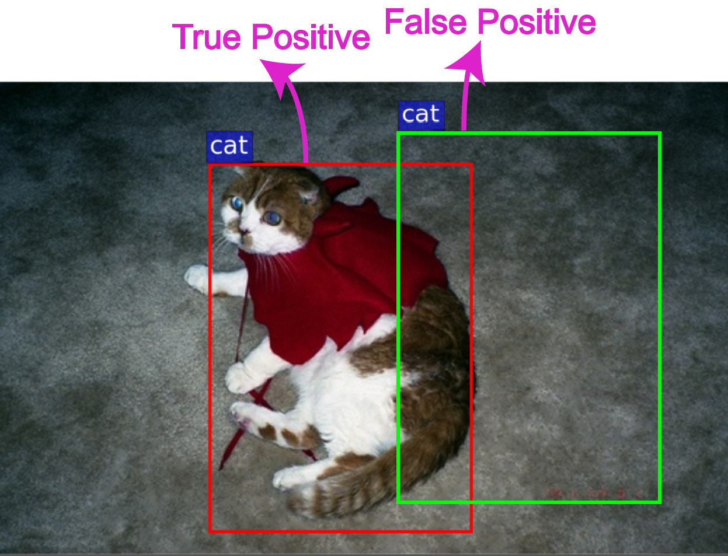
Q2: Where is the object? (Local information)

Slide 6
Sliding Window

Slide 7
Traditional methods
Basic steps
Generate hundreds of sliding windows (about 1000000)
Extract features from each sliding window
Use sophisticated learning methods to classify these features
Limitations
Very slow speed (>= 2 second per image)
Poor accuracy (mean average precision (mAP) < 35%)
Overly complex system

Slide 8
Object Proposal
Instead of searching for an object at every image location and scale, a set of object bounding box proposals is first generated with the goal of reducing the set of positions that need to be further analyzed.

Slide 9
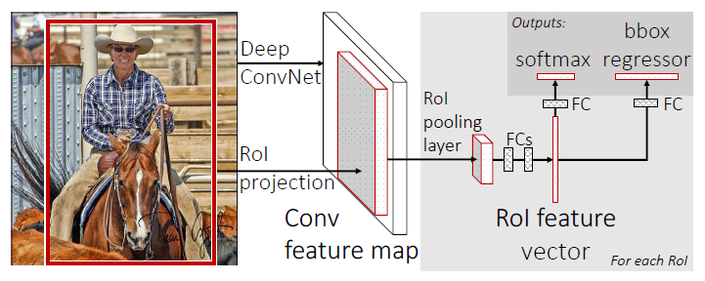
Fast R-CNN
An input image and multiple regions of interest (RoIs) are input into a fully convolutional network.
Each RoI is pooled into a fixed-size feature map and then mapped to a feature vector by fully connected layers (FCs).
The network has two output vectors per RoI: softmax probabilities and per-class bounding-box regression offsets.

Slide 10
The RoI pooling layer
h x w window → H x W grid
each sub-window size h/H x w/W
max pooling in each sub-window
output: H X W (e.g., 7 x 7) feature map
a

Slide 11
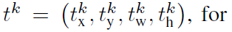
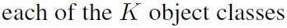
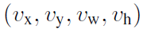
Fast R-CNN
softmax sibling outputs
bbox regressor sibling outputs
ground-truth class
ground-truth bounding-box regression target

Slide 12
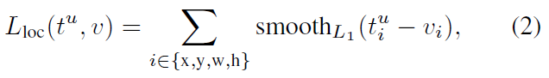
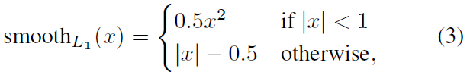
Fast R-CNN
multi-task loss

Slide 13
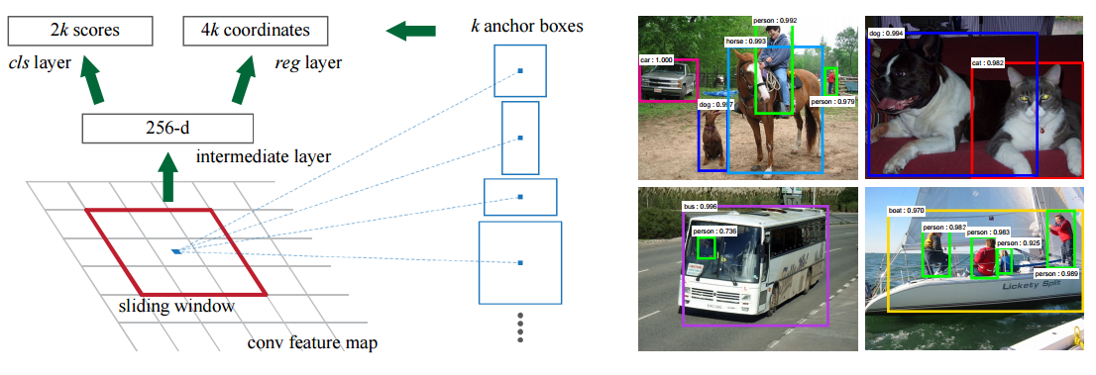
Faster R-CNN

Slide 14

Q & A

